Slide 1
Persuasive Paragraph
Use pages294 to 297
Chapter 8: Launching a new nation

Slide 2
Opening Activity
BY YOURSELF read the subsection titled The French Revolution on pages 295 and 296.
What two conflicts is this subsection talking about?

Slide 3
Persuasive paragraph
You are an official trying to persuade President Adams to do one of the following:
  Remain neutral in the conflict between Great Britain and France.
                OR
  Fight for either the British or the French against the other.

Slide 4


Remember…
The Republicans want us to help the French
  The French helped us in our revolution
  The French did not have a monarchy
  British officers are kidnapping our sailors
      (impressment)
Federalists want us to help the British
  75% of American exports go to Britain
  90% of imports are coming from Britain
  French ships are attacking American ships

Slide 5
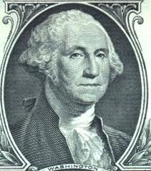
However….
Some people want the US to remain Neutral
  Would not add to the already large debt
  Would not put any American lives at risk
  Could still trade with Great Britain
WWWD????
(What would Washington do?)

Slide 6
Requirements
Letter format (2 points
At least 5 sentences (2 points)
Your stance stated in the 1st sentence (2 points)
2 supporting facts for why Adams should do what you advise (2 points each)
1 direct quote from the book (2 points)
1 closing sentence on how the decision will affect the country (2 points)
                (14 points total)

Slide 7


Quote
Make sure your quote is noted by parentheses and highlighted.
“Most Americans at first supported the French Revolutionaries”.

